Slide 1


TimeSGN: Scalable and Effective Temporal Graph Neural Network
Speaker: Yuanyuan Xu
Yuanyuan Xu, Wenjie Zhang, Ying Zhang, Maria Orlowska, Xuemin Lin
17 May 2024

Slide 2
Outline
Background
Related Work & Observations
Our Solutions
Experiments
Conclusion

Slide 3
Background

Slide 4
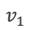
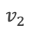
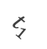
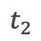
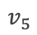
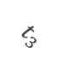
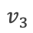
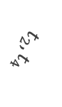
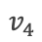
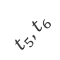
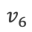
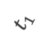
Background
📍What is the Continuous-Time Dynamic Graph (CTDG)?
Definition 1: A continuous-time dynamic graph is constructed by a sequence of temporal interaction events G = {δ(t1), δ(t2), · · · } ordered by timestamps, where δ(t) = (vi, vj , eij (t), t).
$$v_{2}$$
$$v_{1}$$
$$t_{1}$$
$$t_{5},t_{6}$$
$$t_{1}$$
$$t_{2}$$
$$v_{4}$$
$$v_{3}$$
$$t_{3}$$
$$t_{2},t_{4}$$
$$v_{5}$$
$$v_{6}$$
Figure 1: A toy example of CTDG

Slide 5




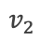
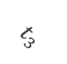
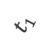
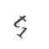
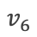
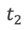
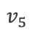
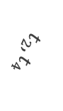
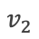
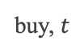
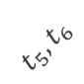
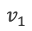
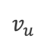
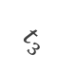
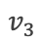

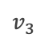
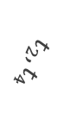
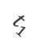
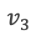
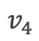
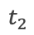


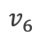
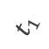
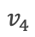
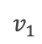
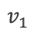
Problem Definition
💡 What is the Representation Learning on Dynamic Graphs?
Definition 2: Given a continuous-time dynamic graph with a sequence of temporal events δ(t) = (vi, vj , eij(t), t), we aim to propose an encoder function F : δ(t) → zi(t), zj(t) ∈ R^{d}, where zi(t), zj(t) represent temporal embeddings of nodes vi and vj at time t, respectively.
$$v_{2}$$
$$v_{2}$$
$$v_{1}$$
?
$$v_{1}$$
$$t_{1}$$
$$t_{5},t_{6}$$
$$v_{1}$$
$$t_{1}$$
$$t_{5},t_{6}$$
$$t_{1}$$
$$t_{1}$$
Encoder Function
$$t_{2}$$
buy, $t$
$$t_{2}$$
$$v_{4}$$
$$v_{3}$$
$$v_{4}$$
$$v_{3}$$
$$t_{3}$$
$$v_{2}$$
$$t_{3}$$
$$t_{2},t_{4}$$
$$v_{u}$$
$$t_{2},t_{4}$$
$$v_{5}$$
$$v_{5}$$
$$v_{6}$$
$$v_{3}$$
$$v_{6}$$
Figure 1: A toy example of CTDG
Figure 2: Temporal embeddings
Figure 3: Downstream tasks

Slide 6
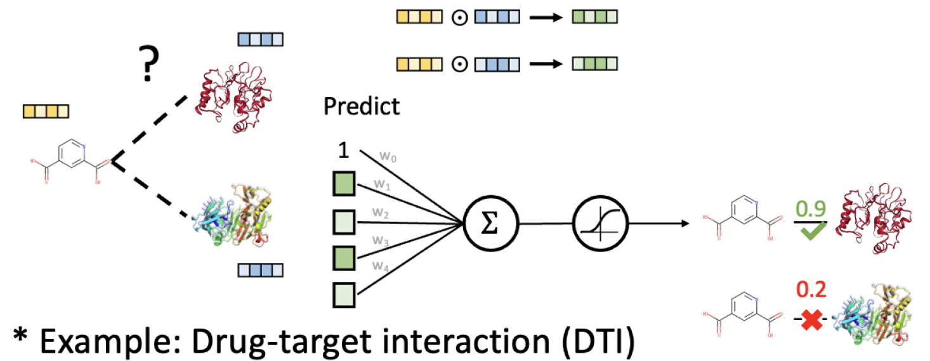
Applications
📲 Edge-based applications
Product recommendation
Drug discovery
Protein Interaction Prediction
…
📲 Node-based applications
Fraud detection
Abnormal user detection
Student dropout prediction
…
Figure 1: Drug discovery
*Example: Next protein interaction prediction
Figure 2: Protein prediction

Slide 7
Related Work Observations

Slide 8

Related Work
[2] DyRep,
ICLR 2019
[4] TGN,
ICML 2020
[6] APAN, SIGMOD 2021
[8] GraphMixer, ICLR 2023
[9] DyGFormer, NIPS 2023
[11] Zebra,
VLDB 2023
Accelerated
Optimization
Memory
Message
Passing
Scalability
Billion-scale
[1]JODIE,
KDD 2018
[3] TGAT,
ICLR 2020
[5] CAW,
ICLR 2021
[7] TGL,
VLDB 2022
[10] Orca,
SIGMOD 2023
[12] Decoupled TGNN,
VLDB 2023
[13] Our work,
ICDE2024

Slide 9
Observation I
Lacking of Temporal Message Passing (TMP) Paradigm.
🔎 Analysis:
Each temporal interaction is denoted as δ(t) = (vi, vj , eij(t), t), where vi and vj are nodes, eij(t) denotes an edge feature vector, and t is the timestamp.
These two types of features exhibit clearly distinct signal patterns.
When concatenated, they tend to mask individual characteristics.
(1) Timestamp feature
(2) Edge feature
(3) Concatenated feature

Slide 10
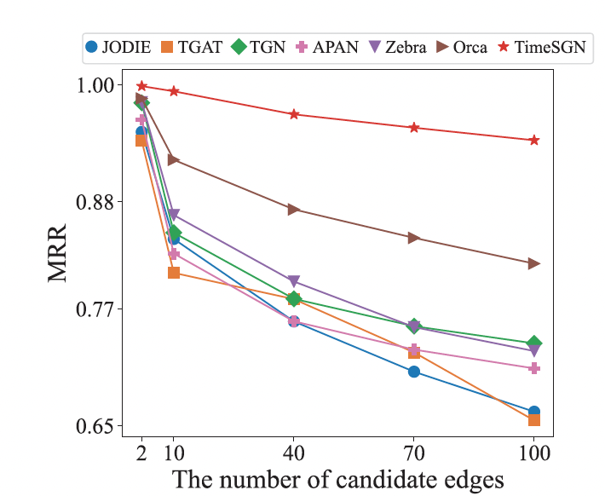
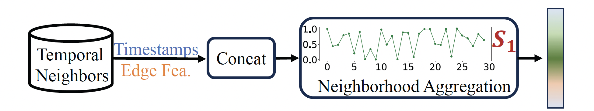
Observation I
Lacking of Temporal Message Passing (TMP) Paradigm.
🔎 Analysis:
Perform well in the binary classification of link prediction (95%)
Significantly drop in more complex scenarios (up to 30.47%↓)
(1) Existing static Message passing
(2) Wikipedia with 0.1M edges

Slide 11
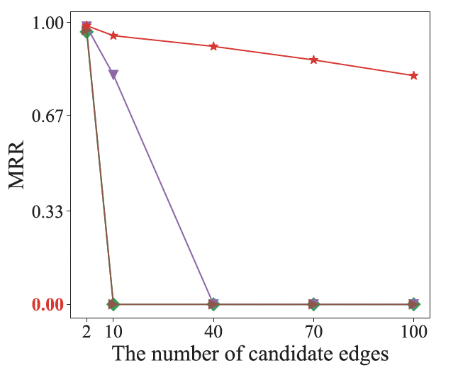
Observation II
Limited Scalability due to High Computation Costs
🔎 Analysis:
Neighbor explosion problem (multi-layer stacking)
Exponential complexity (O(|B| K^{L}), such as TGN
Acceleration techniques cost extra GPU memory
(1) GDELT_ST with 0.2B edges

Slide 12
Our Solutions

Slide 13
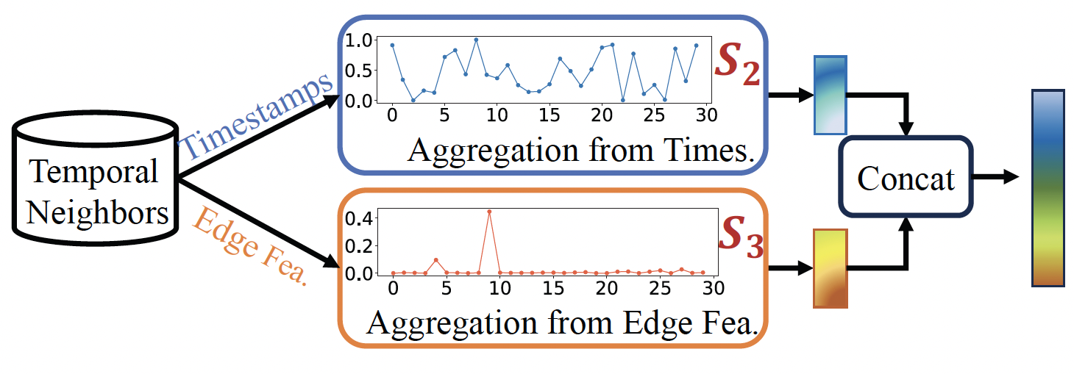
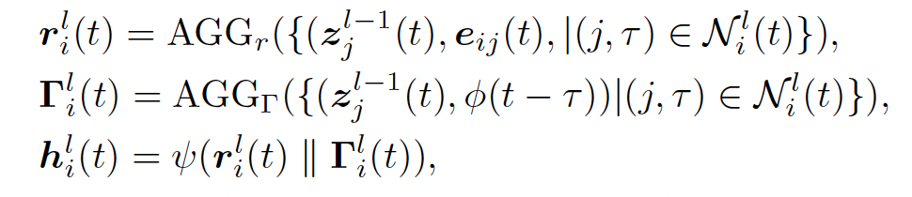
Our Solutions
☛ For Observation I:
Propose divided temporal message passing (DTMP) paradigm for temporal message passing
Its formulation:
Figure 1: DTMP paradigm

Slide 14
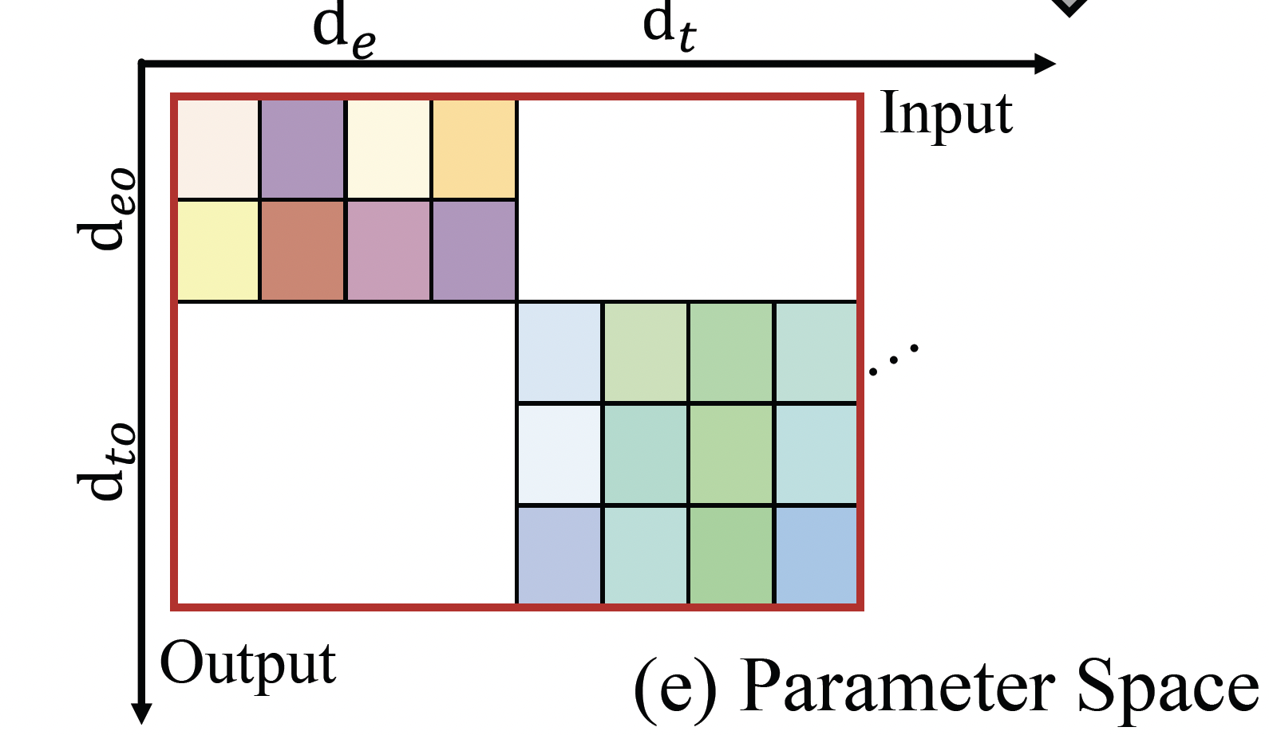
Our Solutions – DTMP Paradigm
Lemma1: Consider a temporal graph neural network denoted by F composed of two main function sets: FT and FS, where FT denotes the function set of the temporal message passing model and FS denotes the state update function set. Suppose FTA is the neighborhood aggregation function in Eq. (2) and is deployed on our proposed divided temporal message passing paradigm, resulting in FDTA in Eqs. (4), (5) and (6). Then the parameter volume of |FDTA| satisfies:
|FDTA| ≤ 1/2|FTA| + ϵ
where ϵ ≪ |FDTA|, a constant and optional term
introduced by Eq. (6).
Figure 1: parameter space

Slide 15
Our Solutions – DTMP Paradigm
Theorem 1. Let FT denote an L-layer static message passing model of the temporal graph neural network, and let FDT represent its variant with the proposed divided temporal message passing paradigm. Then, the expressiveness of FDT is equivalent to that of FT .
📣 Advantages of Our DTMP Paradigm
Reduce up to half of network parameters
Reduce GPU memory usage
Avoid mutual masking of two feature types and enhance the effectiveness of feature learning
Maintain the expressiveness of existing T-GNNs

Slide 16
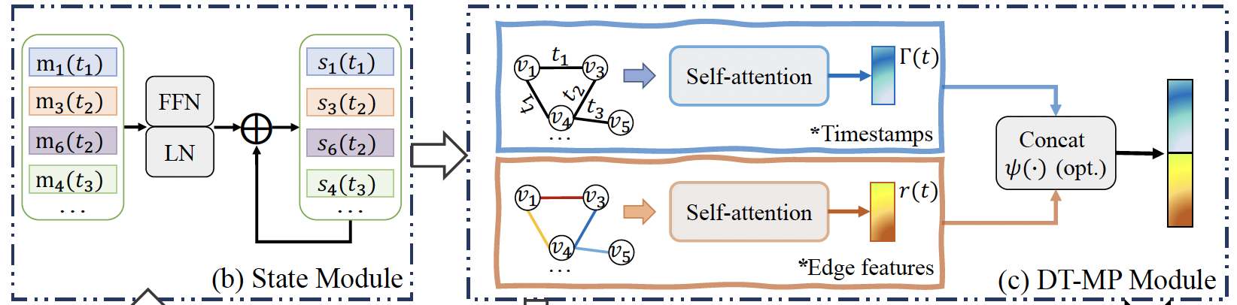
Our Solutions
☛ For Observation II :
Propose a scalable temporal graph neural network.
State Module and divided temporal message passing module
Figure 1: parameter space

Slide 17
The proposed TimeSGN
Existing Node State Update
Sequential model, like RNN and GRU
Expensive and over-smoothing problem
Our Node State Update
Record node add/delete, edge add/delete or feature transformation
Linear model for node state learning
Previous node state
Current messages
Time encodings

Slide 18
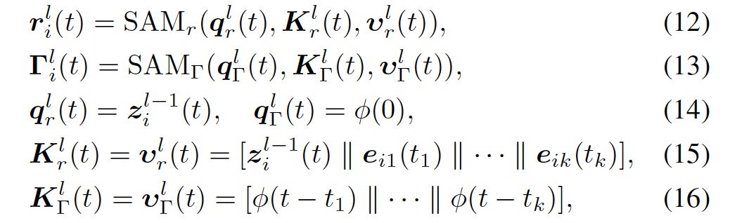
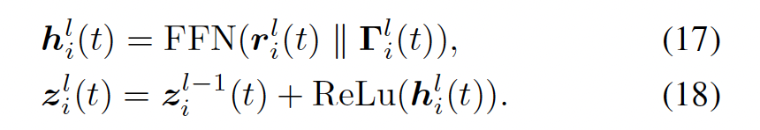
The proposed TimeSGN
Our Divided Temporal Message Passing
Relation Neighbor Attention
Time Neighbor Attention
Feature integration

Slide 19
The proposed TimeSGN
📣 Advantages of Our TimeSGN
Billion-scale temporal graph processing
Capture temporal dependencies
Effective temporal message passing for temporal graph learning
Efficiency in memory usage and time cost
Robust generalization capability

Slide 20
Experiments

Slide 21
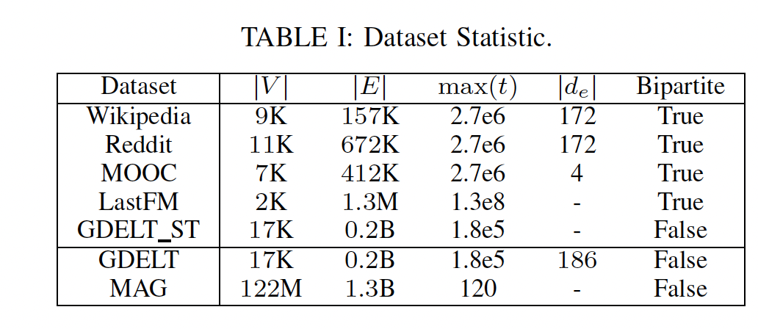
Experiments
Datasets

Slide 22
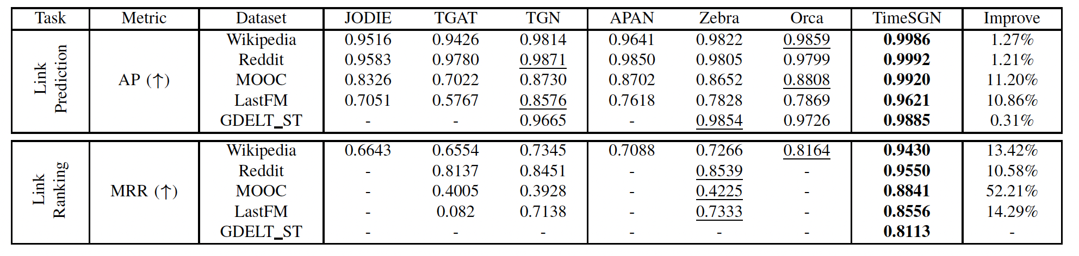

Experiments
Main Results
Transductive
Inductive

Slide 23

Experiments
Consumes 23.55- 50.45% less GPU memory compared to the faster competitor
Achieve 3-258X speed-up
Achieve the best performance in terms of both the memory efficiency and time efficiency

Slide 24

Experiments
Effectiveness of Our DT-MP Paradigm
Save almost 39% and 40% parameters of the temporal message passing model.
Reduce GPU memory usage by up to 62.63% for TGN and 36.47% for Orca.
Improve their performance by an average of 30.10% for TGN and 4.45% for Orca,

Slide 25
Conclusion
📌 A useful findings towards temporal graph learning
Different signal patterns
📌 Propose a universal divided temporal message passing (DT-MP) paradigm
Theoretical guarantee
Easily plug in existing T-GNNs and Recommend for other usage
📌 Design a scalable and effective temporal graph neural network—TimeSGN
📌 Extensive empirical results over 7 datasets
Effectiveness, generalization ability
Time efficiency; Memory efficiency, Scalability

Slide 26
Thanks for your listening

